Slide 1

Class Timetable Management
Team Name:- Hash Include
Team Members:-
Loganathan Sri Shalini – 3122 21 5001 047
Muralisekar Thirisha – 3122 21 5001 056
Kakarla Tejaswi – 3122 21 5001 039

Slide 2
Problem Statement:
To develop a code that generates a class, staff timetables for a university that allocates courses by taking inputs and following the given constraints, without any misallocation of courses or collision of classes.
Input:
Number of Classes
Semester & Branch
Number of theory/lab classes
Name of theory/lab courses
Faculty name for theory/lab courses
Number of periods per week for each class
Output:
A well structured class timetable, staff timetable are generated following all the given constraints.

Slide 3
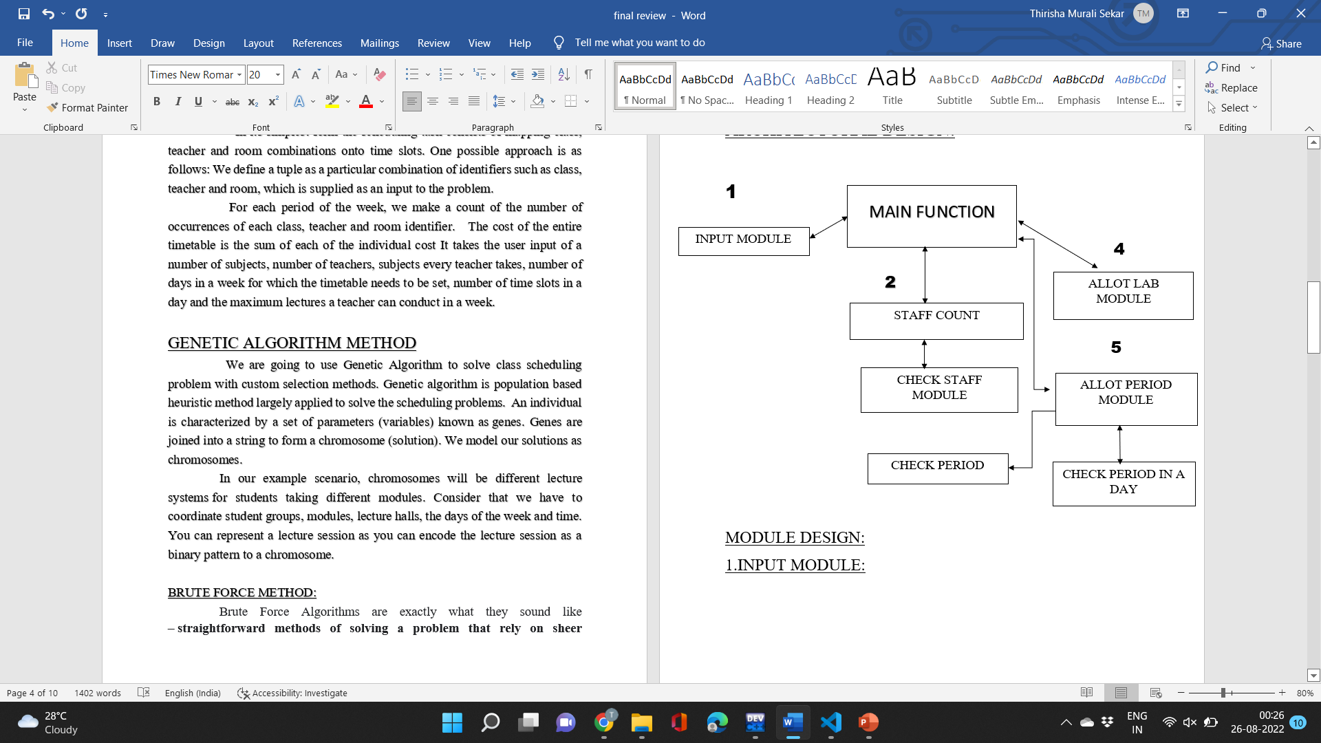
Architectural Design

Slide 4
Module Design
1. INPUT MODULE:
Gets all the required inputs like staff, name of the subject, semester, number of classes and labs using the structure.
2. STAFF COUNT MODULE:
Initially counts the total number of staff with repetition and calls check staff module.
2.1 CHECK STAFF MODULE:
Count the number of staff without repetition using string function and store the name of the staff in a new structure “staff_tt”.

Slide 5
3. ALLOT LAB MODULE:
1.Generate a random number and allots a lab if it is free and if the constraints are satisfied.
2.Store the allotted lab class in a allotted period in the respective staff timetable.
4. ALLOT PERIOD MODULE:
Generate a random number and allot a period if the period is free, then calls check period and check period in a day module and verifies the constraints.
Stores the name of subject in an allotted period for a respective staff.
4.1 CHECK PERIOD:
Check the previous timetable and allots the class without clash.
4.2 CHECK PERIOD IN A DAY:
Checks for a repetition of period in a day.

Slide 6
Constraints
Soft Constraints:
Lab should not be allotted in the first/last period.
First period should not be free, it must be allotted.
Hard Constraints:
Two lectures shouldn’t be allotted in same time for a class.
No two consecutive classes for a staff.
6 periods per day(30 periods per week).
No 2 lab classes in same day.
Break should be provided before or after a lab class.
Different classes should not be allocated to one lecturer at same time.

Slide 7
References:- [1] E.K. Burke and P. De Casemakers (2003). The Practice and Theory of Automated Time- tabling IV: Revised Selected Papers from the 4th International conference, Gent 2002, Springer Lecture Notes in Computer Science, vol. 2740, Springer. [2] E.K. Burke and M. Trick (2005). The Practice and Theory of Automated Timetabling V: Re- vised Selected Papers from the 5th International conference, Pittsburgh 2004, Springer Lecture Notes in Computer Science, vol. 3616, Springer. [3] E.K. Burke and Hana Rudová (2006). Proceedings of the 6th International Conference on the Practice and Theory of Automated Timetabling, Masaryk University.

